Slide 1
Sentiment Analysis in Program Development
Linna Qian
linna@ualberta.ca
Department of Computing Science
University of Alberta
August 2018

Slide 2


Introduction
The Problem Statement:
Software development can be affected by the workers¹
Bad days can affect the production of a company
Difficult for big companies to gauge how their employees feel²
¹https://jaxenter.com/wp-content/uploads/2014/09/angry.png
²http://teamqualitypro.com/wp-content/uploads/b-what-CEOs-want-and-need-to-know.png

Slide 3
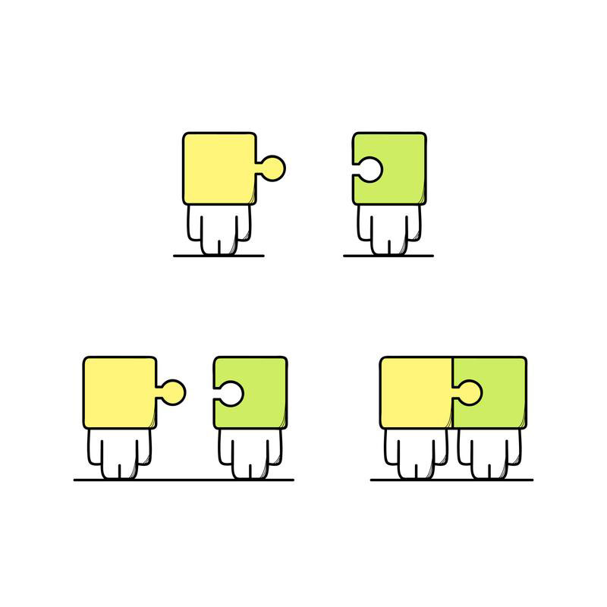
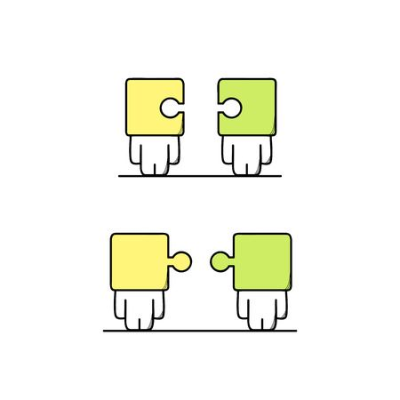
Research Question
Do the feelings of software developers, about their program, affect the success of Travis CI builds?¹
or

Slide 4

Background
Sentiment analysis
Computational process of determining whether the opinion expressed in a piece of text is positive, negative, or neutral ¹
Used to determine how people feel about a certain topic²
Plays an important role in social media and other business initiatives
Used to improve customer service and relations

Slide 5


Project Objectives
Use sentiment analysis to extract the sentiment of developer pushed commit messages and compare it to the success of the build
Create a visual representation, in the form of a calendar, from the data extracted¹

Slide 6
Definitions and Examples

Slide 7


GitHub and Travis CI
GitHub
A website where programmers can store their projects for others to see, use, and develop¹
Travis CI
A continuous integration platform that automatically builds and tests code changes²

Slide 8
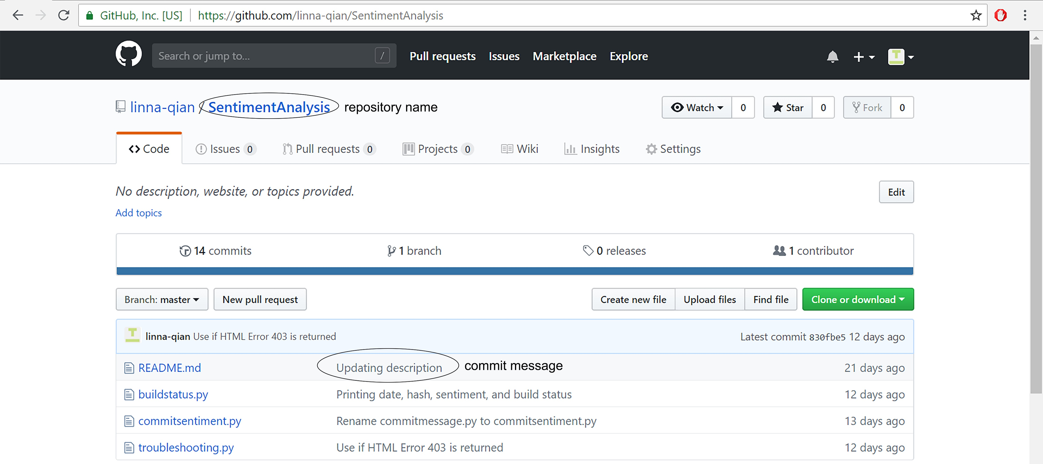
GitHub Terms
A GitHub repository is where the contents of a project are stored (project file)
Commit messages are messages that programmers attach to the work when they upload to their repository

Slide 9
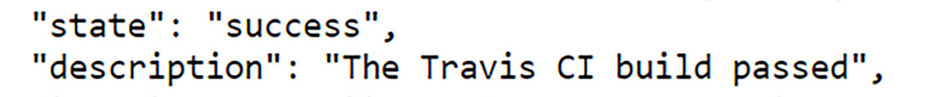
Travis CI Terms
Continuous Integration
Merging smaller code changes more frequently rather than one big merge at the end¹
Travis CI Builds
The GitHub repository will be copied and tested in a virtual environment. If any part of the build fails, the build status returned will be either errored or failed¹

Slide 10
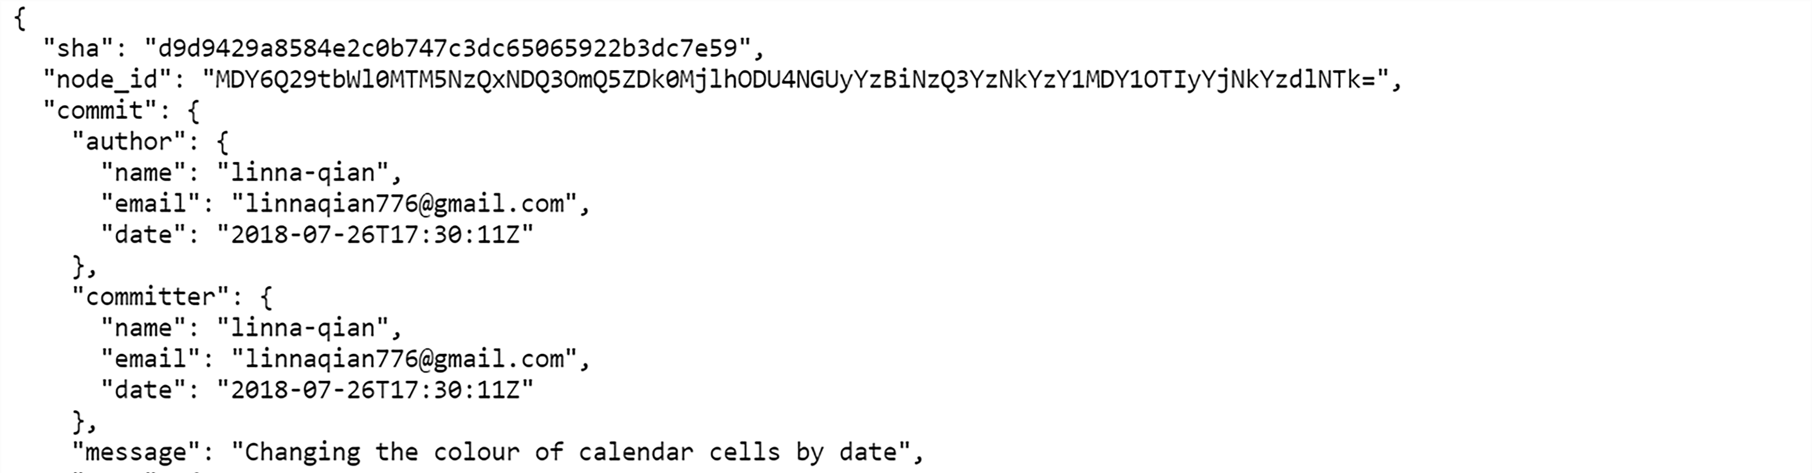
API and JSON
API (Application Programming Interface)
API is what allows remote servers and web applications to communicate. It receives requests from the user and sends a response back¹
JSON (JavaScript Object Notation)
JSON is a formatting used in data transfer between remote servers and web applications

Slide 11
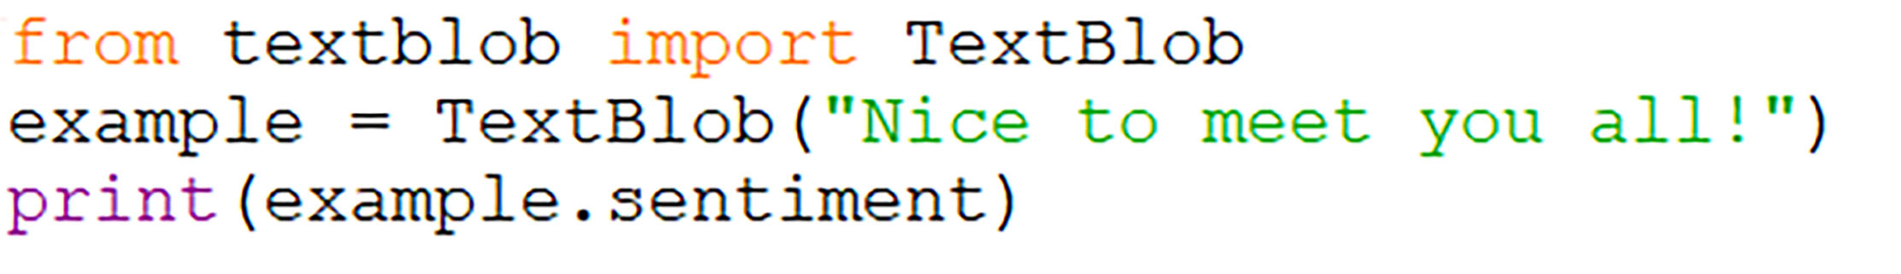
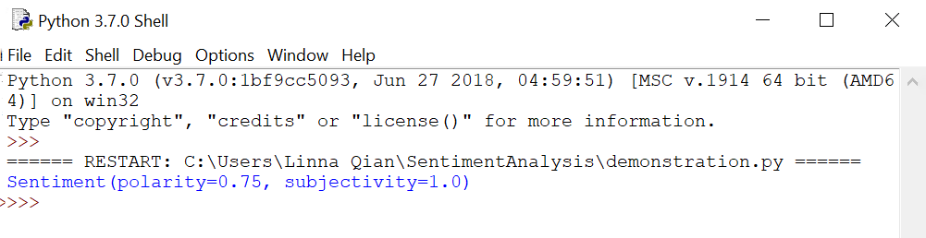
TextBlob
The sentiment of the commit messages will be extracted with a Python library called TextBlob. It will return the sentiment as a value between -1 and +1

Slide 12
The Research Process

Slide 13
Overview of Research Process
Extract sentiment of commit messages
Convert to JSON format
Extract commit messages from GitHub repository
Combine the data into a list
Visualize data in calendar
Extract build status from Travis CI
Successful build = green background
Failed build = red
Positive sentiment = 😃
Negative = 😭

Slide 14
Results
Little detectable sentiment in pushed commit messages
Primarily successful builds; only a few builds failed
Limited numbers of builds
Program builds are widely spread out over two years

Slide 15

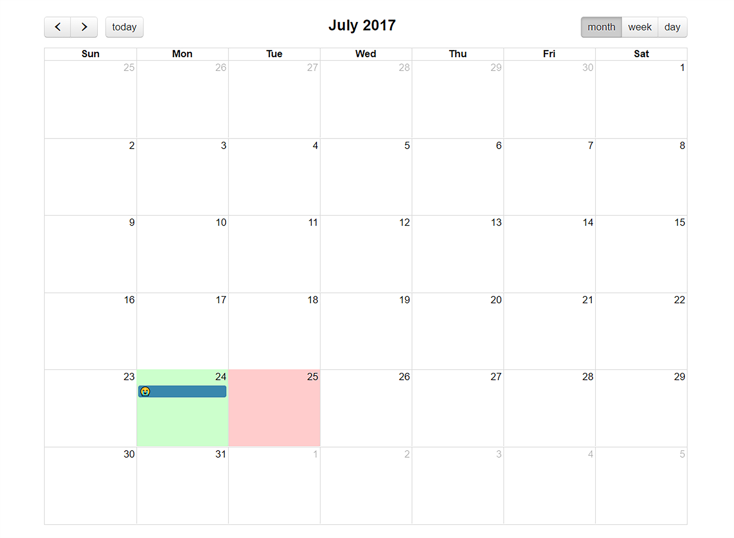

Slide 16
Conclusions
Data provides some evidence that the emotions experienced by software developers may affect the success of program builds
Dataset is too small to make a generalization about the relationship between the sentiment of commit messages pushed by developers and the success of their program builds

Slide 17
Improvements
Preprocess the commit messages to remove text like URLs and code snippets
Use multiple repositories to see the relationship between the sentiment of commit messages and the success of Travis CI builds
Adjust sentiment values based on the type of text being analyzed (commit messages for this project)

Slide 18
Future Applications
Improving the accuracy of sentiment analysis programs
Analyzing, not only text, but pictures and videos
Increasing the complexity of text able to be analyzed
Examples include: sarcasm and hyperboles¹

Slide 19
Acknowledgements
I would like to thank Dr. Sarah Nadi and Moein Owhadi-Kareshk for welcoming me into the SMR lab and giving me the opportunity to learn about sentiment analysis and program development.
I would also like to thank the Ross and Verna Tate foundation for providing me this opportunity through the High School Internship Program (HIP).

